Slide 1

Compiler Design
Preet Kanwal
Department of Computer Science & Engineering
Teaching Assistant : Sanket N D

Slide 2

Compiler Design
Unit 2
Recursive Descent Parsers with Backtracking
Preet Kanwal
Department of Computer Science & Engineering

Slide 3
Compiler Design
Recap - Top Down Parsers
Top down parsing involves constructing a parse tree from the start symbol and attempting to transform the start symbol to the input.
Top down parsing is based on Left Most Derivation of input string.
There are two types of top-down parsing
Top-down
With backtracking
Without backtracking
techniques:
With Backtracking
Without Backtracking
RDP
Predictive Parser/LL(1)

Slide 4
Compiler Design
Top Down Parsing with Backtracking
Top-down parsers with backtracking can be implemented by using procedures.
This implementation design is called Recursive Descent Parsing (RDP).
In RDP, procedures are written for each non terminal in the grammar.

Slide 5
Compiler Design
Recursive Descent Parsing with backtracking
For example, the pseudocode below shows procedures written for the non terminals present in the following grammar -
S A
→ c A d
→ a b | a
A() {
isave = inputPointer(); if(inputSymbol++ == ‘a’)
{
if(inputSymbol++ == ‘b’) { return true;
}
}
inputSymbol = isave; if(inputSymbol++ == ‘a’) {
return true;
}
return false;
}
S() {
if(inputSymbol++ == ‘c’)
{
if(A())
{
if(inputSymbol++ == ‘d’)
{
return true;
}
}
}
return false;
}

Slide 6
Compiler Design
RDP With backtracking - Example 1
Consider the earlier grammar -
S A
→ c A d
→ a b | a
Let the input string be w = ‘cad’

Slide 7
Compiler Design
Recursive Descent Parsing with backtracking
Points to keep in mind while performing RDP with backtracking-
Try different alternatives of a nonterminal in the way it is listed in the grammar.
If at least one alternative matches, the input string can be parsed.

Slide 8
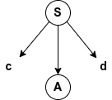
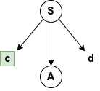
Compiler Design
RDP With backtracking - Example 1
We will start with S, which is the start symbol for the grammar.
The first production of S, (S -> cAd) matches with the leftmost letter of input c.
So we consider this production and continue.
The input letter now advances to a.

Slide 9
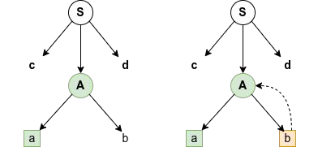
Compiler Design
RDP With backtracking - Example 1
Now, we need to expand the non-terminal A.
The input letter is a. The first production of A is A -> ab. This matches current input letter a.
However, since the next input letter is d and this doesn’t match the current production A -> ab.
So, we backtrack to check the next production.

Slide 10
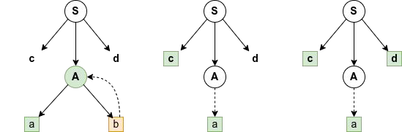
Compiler Design
RDP With backtracking - Example 1
The next production A -> a. This matches with the input letter a, so we accept this production and expand A.
After expansion, the next input letter d matches the remaining part of the first production.
We see that all the input letters are matched correctly and are also in order.
Hence, the string is accepted by the parser.

Slide 11
Compiler Design
RDP With backtracking - Example 2
Consider the following grammar - S → r X d | r Z d
X | → | o a | | | e a
Z | → | a i
Let the input string be w = ‘read’

Slide 12
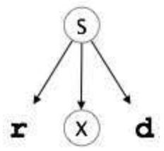
Compiler Design
RDP With backtracking - Example 2
We will start with S, which is the start symbol for the grammar.
The first production of S, (S -> rXd) matches with the left-most letter of input r.
So we consider this production and continue.
The input letter now advances to e

Slide 13
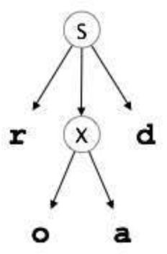
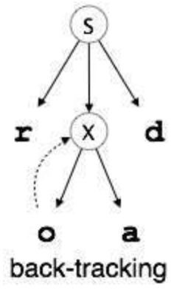
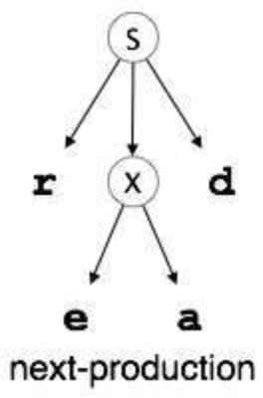
Compiler Design
RDP With backtracking - Example 2
Now, we need to expand the non-terminal X.
The input letter is e. The first production of X is X -> oa. This doesn’t match with the current input letter e. So, we backtrack and check the next production X -> ea. This matches with the input letter e, so we accept this production and expand X.
After expansion, we see that all the input letters are matched correctly and are also in order. Hence, the string is accepted by the parser.

Slide 14
Compiler Design
Drawbacks of RDP with backtracking
Parser program may not accept the input even if the input string belonged to the grammar because of the order of productions.
RDP with backtracking cannot work with left recursive grammars because it would cause the program to enter an infinite loop.
Reversing semantic actions during the parsing of a string using RDP with backtracking is an overhead.

Slide 15
Compiler Design
Drawbacks of RDP with backtracking
Parser may not accept a valid input
Alternative productions are tried out in the order in which they are listed in the grammar.
This could sometimes cause the parser program to throw
an error grammar.
Example -
even if the input string belonged to the
Consider the grammar from Example 1 -
S A
→ c A d
→ a b | a
Suppose the second production was changed to A → a | a b
How would the input string cabd be parsed?

Slide 16
Compiler Design
Drawbacks of RDP with backtracking
Given -
S A
→ c A d
→ a | a b
Input string - cabd
The first production of S, (S -> cAd) matches with the leftmost letter of input c.
The input letter now advances to a.
Expand the non-terminal A. The first production of A is A -> a.
This matches current input letter a.

Slide 17
Compiler Design
Drawbacks of RDP with backtracking
The next input letter is b.
This does not match the remaining part of the first production S -> cAd.
So, we backtrack to check the next production.
The next production A -> ab. This matches with the input letter a, so we accept this production and expand A.
The next input letter b matches the remaining part of the production.
The next input letter d matches the remaining part of the first production.
We see that all the input letters are matched correctly and are also in order. Hence, the string is accepted by the parser.
Notice that if the productions were unchanged, the input string would be accepted without backtracking.

Slide 18
Compiler Design
Drawbacks of RDP with backtracking
Cannot work with Left Recursive Grammars
Left recursive grammars would cause the program to enter an infinite loop.
Example -
Consider the following grammar rule A -> Aa | b
Procedure A() would roughly have the following pseudocode:
A() {
if (A()) {
…
}
This causes an infinite loop.
Thus, RDP with backtracking cannot work with left recursive grammars.

Slide 19
Compiler Design
Drawbacks of RDP with backtracking
Overhead
RDP with backtracking involves a series of erroneous expansions and corresponding semantic actions.
Reversing semantic actions during the parsing of a string causes substantial overhead.

Slide 20
Compiler Design
Question - Working of RDP
Consider the language defined by grammar S -> aSa | aa , which ideally accepts L(G) = { a^{2n}, n>=1 }
Show the working of RDP for the following input strings -
aa
aaaa
aaaaaa
aaaaaaaa
All the strings belong to L(G)

Slide 21
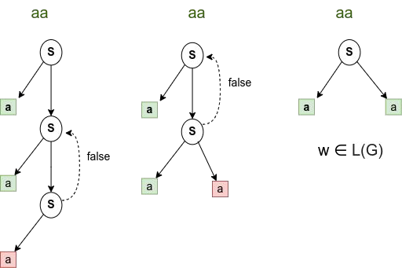
Compiler Design Solution - aa

Slide 22
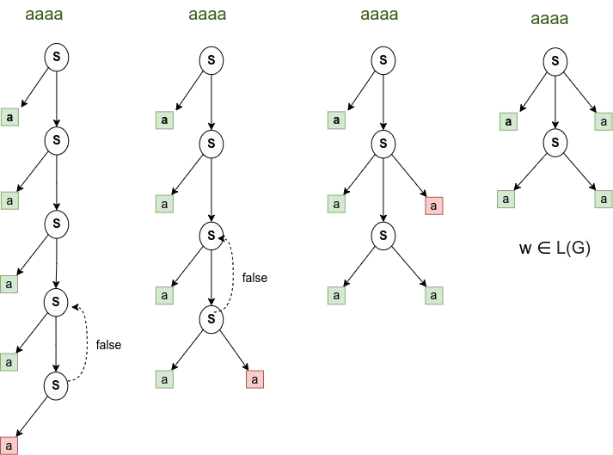
Compiler Design Solution - aaaa

Slide 23
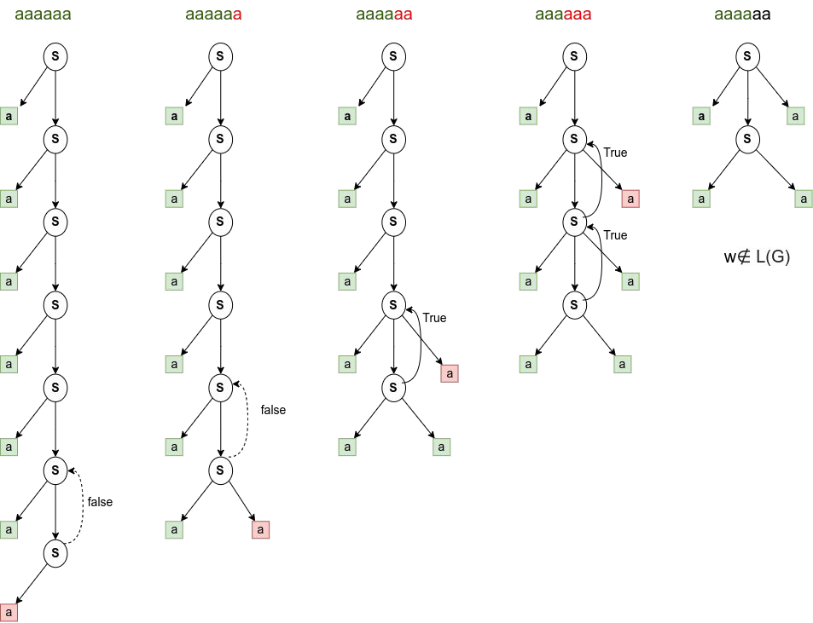
Compiler Design Solution - aaaaaa

Slide 24
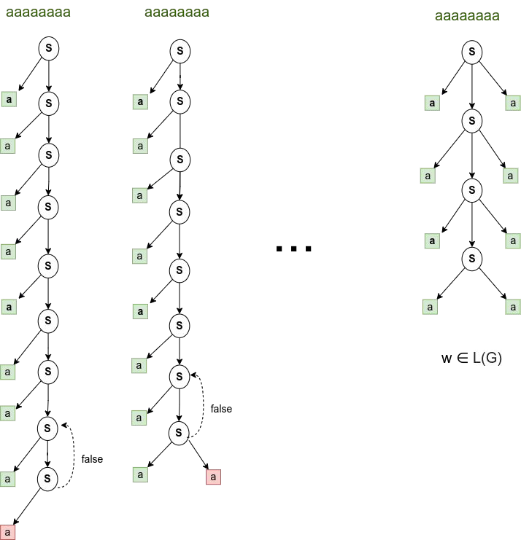
Compiler Design Solution - aaaaaaaa

Slide 25
Compiler Design
Question - Working of RDP
The above working shows that the string aaaaaa cannot be parsed using RDP with backtracking.
Input String | RDP with Backtracking | Language
_{a}2 | Accepts | Accepts
_{a}4 | Accepts | Accepts
_{a}6 | Not accepted | Accepts
_{a}8 | Accepts | Accepts
It is evident that only strings of the form a^{2^n} is accepted by the RDP with backtracking.

Slide 26
THANK YOU
Preet Kanwal
Department of Computer Science & Engineering
preetkanwal@pes.edu

